Slide 1
Spanish Accent Classification System for Voice Assistant
Diego Freire, Martine Harrison, Stefanie Reed

Slide 2
Overview
Introduction
ASR Process
Accent Classification Task
Goal
Create an Spanish Accent Classification Model using Mozilla Common Voice + Evaluate Results
Compare scores with SVM results tested on English (Pedersen 2007)
Compare scores with MLP/CNN results tested on English (Ahamad 2020)
Experiment
Data Exploration and Data Cleaning
MFCC Feature Extraction
Create SVM Model
Evaluation
Accuracy Score and AUC
Results
Discussion
Notes:
Stef

Slide 3
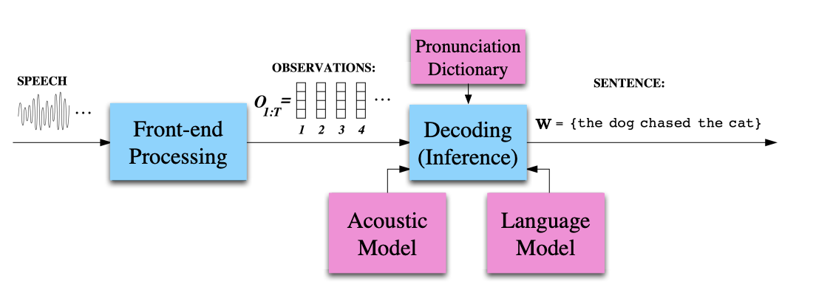
Introduction: Automatic speaker recognition
Components:
Front-end processing A.k.a Feature Extraction Acoustic signal → vectors
Acoustic model Statistical model mapping signal to speech (sounds or words)
Language model
Dictionary (knowledge-based)
Decoding algorithm
Downstream Tasks:
Voice user interfaces
Speaker identification (biometrics)
Telephony for the deaf, hearing- or motor-impaired
Keyword spotting (e.g., at the NSA)
Academic
Captioning
Transcription (medical, legal)
Notes:
aim of an automatic speech recognition (ASR) system is to produce a word sequence (transcription) given a speech waveform. sampled waveform converted into a sequence of time-discrete parametric vectors
first stage of speech recognition is to compress the speech signals into a sequence of acoustic feature vectors, referred to as observations, denoted as O = {o1, . . . , oT }. is process is known as the feature extraction or front-end processing. Given the observation sequence, generally two main sources of information are required to decode the most likely word sequence: the language model and acoustic model
Dictionary: ○ A hand-written guide to what sounds are in each word ● Language model: ○ A statistical model of how common words & phrases are ○ Currently a very fast-moving area of research ● Acoustic model: ○ Statistical model mapping signal to speech (sounds or words) Voice user interfaces (virtual assistants, voice dialing, voice search, etc.)
Speaker identification (biometrics)
Telephony for the deaf, hearing- or motor-impaired
Fluency evaluation, accent reduction, etc.
Keyword spotting (e.g., at the NSA)
Academic
Captioning
Transcription (medical, etc)

Slide 4
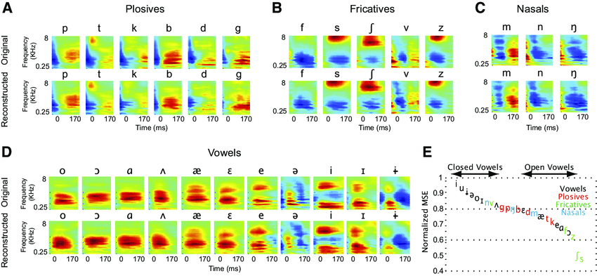
Introduction: Task
English ASR systems are very well-developed
Companies focus to develop systems in English
Other languages are neglected & misrepresented
(e.g. low-resource & non-commercially important languages)
Spanish ASR systems used European Spanish more frequently
Things are changing, but there is still work to do
We address speech variation as dialect/accent and how phonemes(sounds of a language) differ
Notes:
Stef

Slide 5
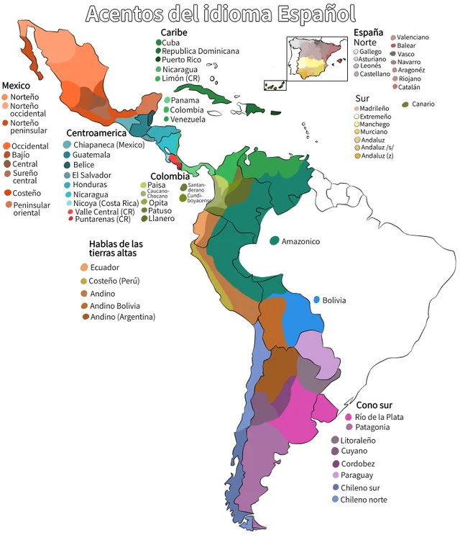
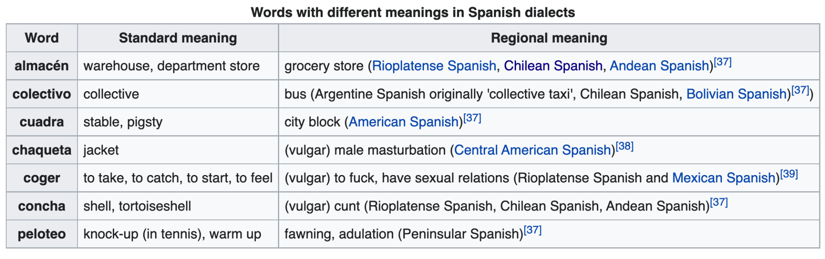
Spanish Dialects and accents
Concerns:
Speech errors
“How to recognize speech” → “How to wreck a nice beach”
ASR-NLP-TTS pipeline
Consequences for:
Internationalization (i18n)
Localization (l10n)
Notes:
Stef

Slide 6
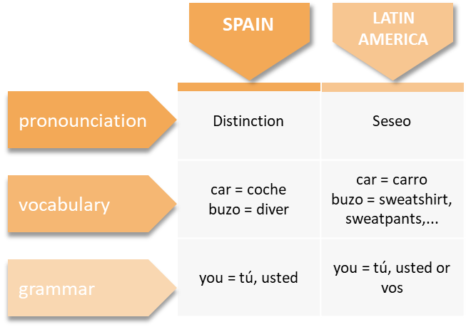
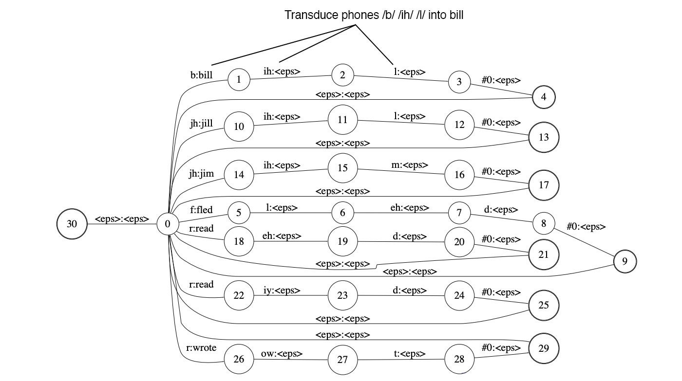
Introduction: Task (ct’d)
Dialect refers to a particular form of a language:
Pronunciation, vocabulary, and grammar
Accent = Pronunciation
Dialect identification in ASR = discriminating between members of the same language, instead of different languages.
Past approaches: KNN all the way through to Deep Learning & Hybrid Rule-based
SoTA = Deep Learning (Duduka 2020)
High-quality vs. low-latency
Clean environment vs. noisy environment
Our approach: Discriminative classifier using SVM
Notes:
Stef

Slide 7
Data
Mozilla Common Voice dataset: is an open-source multi-language dataset of voices
Comprised of MP3 and corresponding text files
Since it is open source, it is not proprietary in the same way as many other voice datasets
Most voice datasets over-represent white and English-speaking males: Mozilla Common Voice presents itself as an alternative to this norm
The dataset is subdivided into train, dev, and test portions with tags for high-quality data
that is validated, and low-quality data
Metadata:
A speaker ID for each recording where each recording is ~ a sentence or less
The path to the audio file
A decoded audio array and its sampling rate
A transcription of the sentence produced by the speaker
How many upvotes the audio file received from reviewers
Age
Gender
Accent based on region
Notes:
Martine

Slide 8

Data
Viaja al Paraguay en dos ocasiones
Hizo aplaudidas audiciones en Radio Antártida Argentina y Belgrano
Dale cuerda a la rana

Slide 9
Data
According to the Common Voice dataset description:
Data Splits
The speech material has been subdivided into portions for dev, train, test, validated, invalidated, reported and other.
The validated data is data that has been validated with reviewers and received upvotes that the data is of high quality.
The invalidated data is data has been invalidated by reviewers and received downvotes that the data is of low quality.
The reported data is data that has been reported, for different reasons.
The other data is data that has not yet been reviewed.
The dev, test, train are all data that has been reviewed, deemed of high quality and split into dev, test and train.
Notes:
Martine

Slide 10
Data Exploration- Accents
Accent | Count
España: Sur peninsular (Andalucia, Extremadura, Murcia) | 37430
España: Norte peninsular (Asturias, Castilla y León, Cantabria, País Vasco, Navarra, Aragón, La Rioja, Guadalajara, Cuenca) | 29043
México | 15449
Andino-Pacífico: Colombia, Perú, Ecuador, oeste de Bolivia y Venezuela andina | 11699
Rioplatense: Argentina, Uruguay, este de Bolivia, Paraguay | 10621
España: Centro-Sur peninsular (Madrid, Toledo, Castilla-La Mancha) | 7904
Caribe: Cuba, Venezuela, Puerto Rico, República Dominicana, Panamá, Colombia caribeña, México caribeño, Costa del golfo de México | 7661
América central | 5565
Chileno: Chile, Cuyo | 3918
Notes:
Martine

Slide 11
Data Cleaning
Not all audio files are high-quality enough to be informative (lack of clarity, background noise, etc)
We had to decide what audio files to use
Common Voice rates the files with Up Votes and Down Votes
The best files are considered to have 2 Up Votes out of 3
Convert from .mp3 to .wav
Notes:
Diego: During the data cleaning phase, we made some interesting discoveries around the data set.
The open source nature of common voice allows anyone to participate. Which is great, because anyone can participate.
However, the hardware used for the recordings is not standard and the quality of the audio recordings is different.
All the audio clips were mp3, so we converted them to wav which is the standard
Many of the sentences read were bilingual. They started in spanish, and at some point they were english (Eg. names or titles of books)
Common Voice rates the files with Up Votes and Down Votes, and they recommend to use files that have 2 up votes out of 3
That is how we got our final clips.

Slide 12
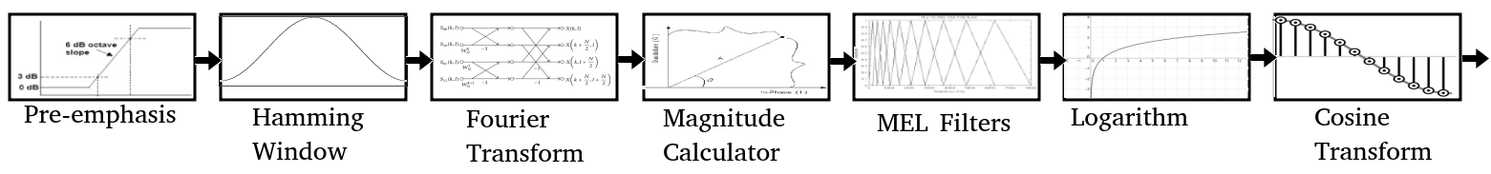
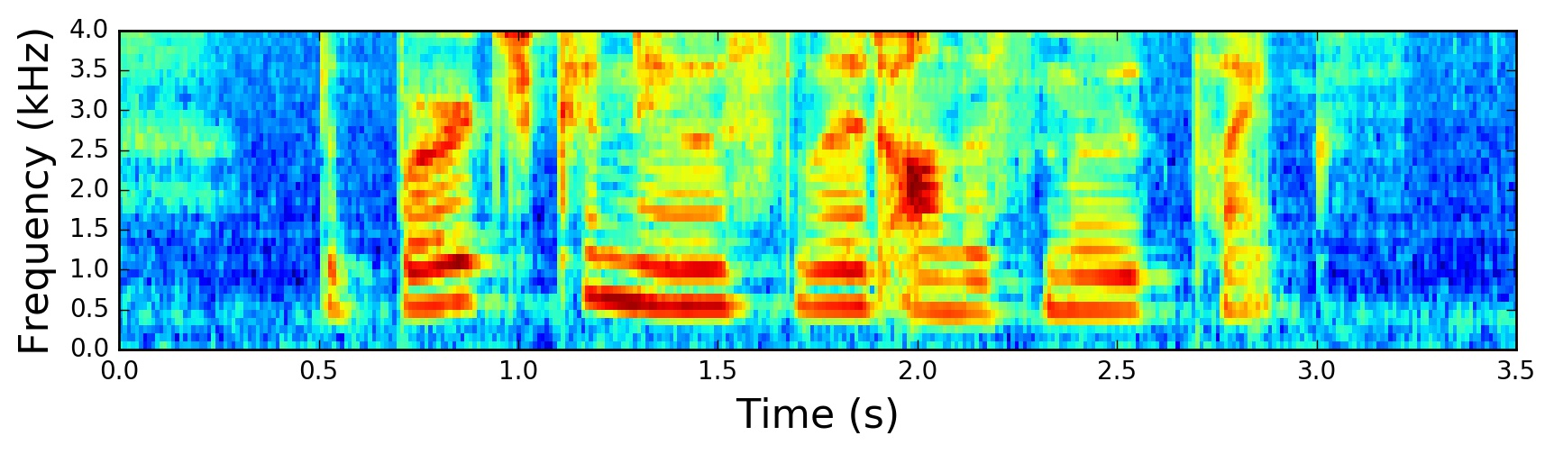
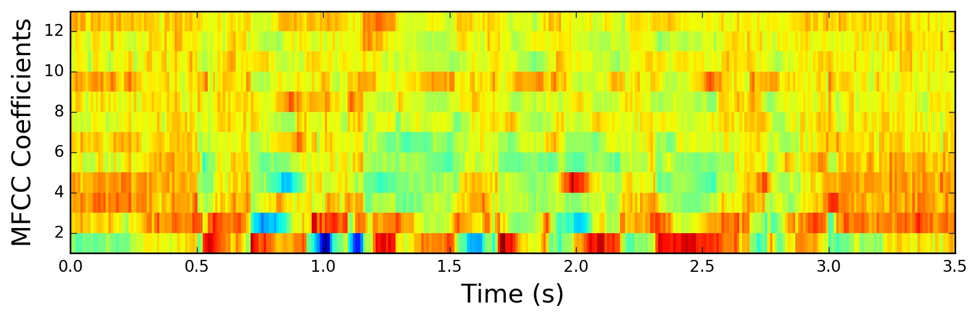
Feature Extraction
We used Librosa to extract data from the Wav Files
MFCC: Mel-frequency cepstrum
The MFCC feature extraction technique basically includes windowing the signal, applying the Discrete Fourier Transform, taking the log of the magnitude, and then warping the frequencies on a Mel scale, followed by applying the inverse Discrete Cosine Transform.
They represent the Phonemes.
Notes:
Diego: The audio files need to be represented in a format that can be understood by the computer, in other words, numbers.
For this task we used a library called Librosa, which is widely used for audio analysis, that we used to obtain the signals from the files.
We extracted the Mel-Frequency Cepstrum Coefficients, aka MFCC. There are up to 39 features, but based on our research we used only 13 for our project.

Slide 13
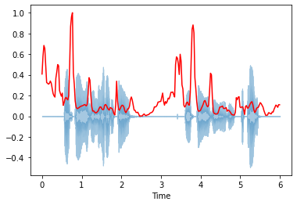
Feature Extraction
Spectral Centroid A measure used in digital signal processing to characterise a spectrum. It indicates where the center of mass of the spectrum is located. Perceptually, it has a robust connection with the impression of brightness of a sound.
Notes:
Diego: Additionally, we extracted the Spectral Centroid. It allows to determine the brightness of sound

Slide 14
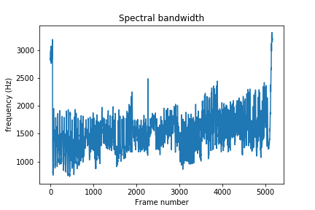
Feature Extraction
Spectral Bandwidth
It is the Wavelength interval in which a radiated spectral quantity is not less than half its maximum value.
Notes:
Diego: The spectral bandwidth which shows the high and low frequencies

Slide 15
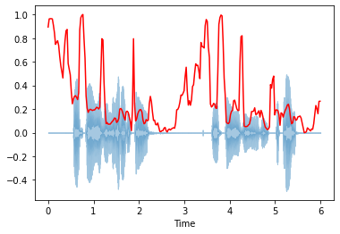
Feature Extraction
Spectral Rolloff
Is the frequency below which a specified percentage of the total spectral energy, e.g. 85%, lies.
Notes:
Diego: Spectral Rolloff represents the amount of vibration at each individual frequency

Slide 16
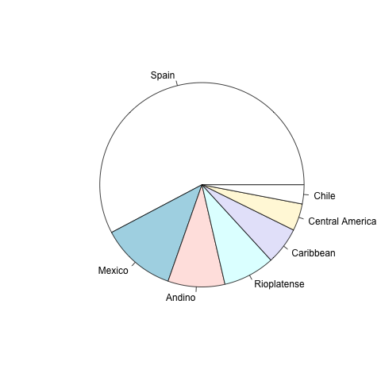
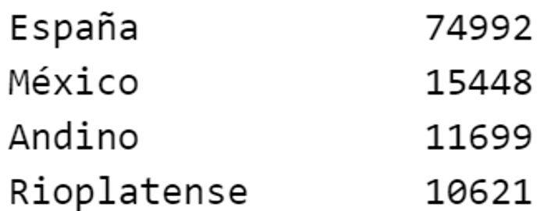
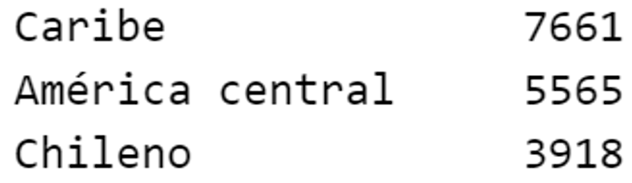
Final Data set
We cleared the data set and extracted:
13 MFCC features
Spectral Centroid
Spectral Bandwidth
Spectral Rolloff
The final training data set contains:
Notes:
Diego: Here are some details about the final data set we obtained for training and testing.
As I explained earlier, we used 13 MFCC features.
Obtaining these values took around 13 hours of compute time

Slide 17
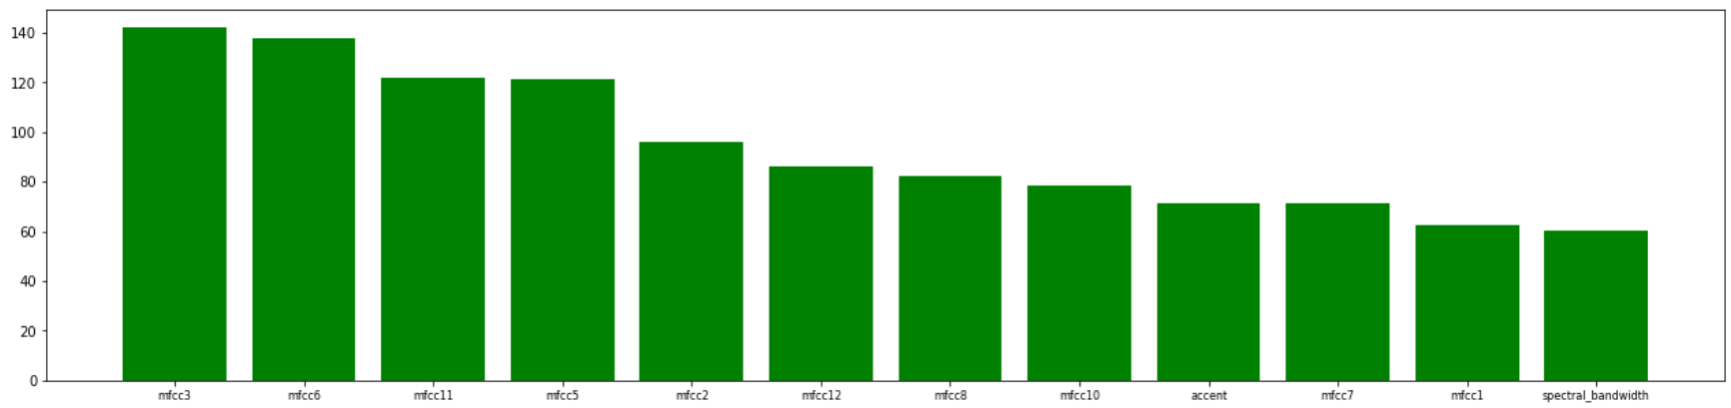
Feature Selection
Before proceeding to train a model, we standarized the data using Standard Scaler
Finally, we used feature selection to get the best features.
Note: Each model has different features because the audio files are different.
Notes:
Diego: With the complete data set, we proceed to train the model. But first,
We used Sklearn Feature selection module to obtain the best features for each model.

Slide 18
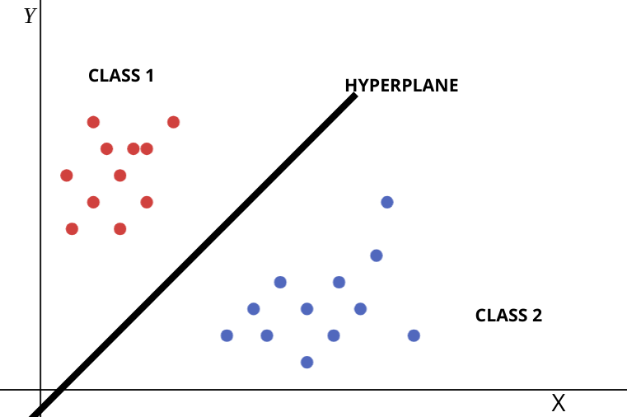
Model - SVM
Supervised Learning Model
Used for Classification and Regression Analysis
In NLP: Frequently used for text classification tasks
This is a good algorithm for Binary Classification, but it doesn’t support multiclass classification natively
Notes:
Diego: For training our model we used the Support Vector Classifier from Sklearn, based on SVM.
In NLP, this algorithm can be used for Classification and based on our research it was a good alternative.
We found that SVMs don’t support multiclass classification natively, but there are alternatives to achieve this.
As you know SVMs use the hyperplane that can be adjusted to best fit the data using the Kernel trick.

Slide 19
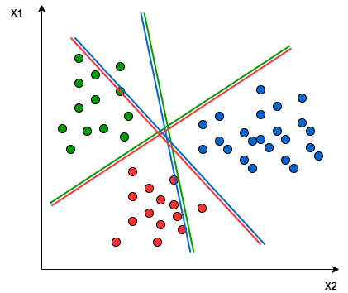
Model - SVM
SVM for Multiclass Classification can be accomplished in two different approaches.
One Vs One (OVO): Separates the data between every two classes.
For example:
Green vs Red
Red vs Blue
Blue vs Green
m(m-1)/2
Notes:
Diego: One vs One, creates multiple binary classification models depending of the number of classes

Slide 20
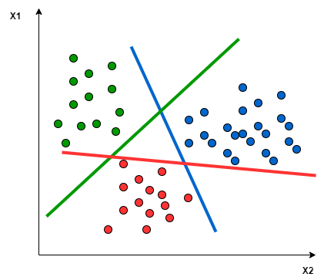
Model - SVM
One Vs Rest (OVR): Divides the data in two groups. A group for the class points, and a group for all other points.
For Example:
Green vs [Blue, Red]
Blue vs [Green, Red]
Red vs [Green, Blue]
Notes:
Diego: One vs Rest, which divides the data in two groups.
Class points and group of other points.

Slide 21
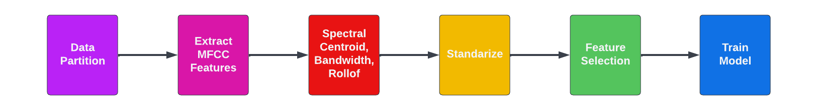
Model - SVM
Training Pipeline
Notes:
Diego:
We tried both approaches. After a few experiments, we came out with this pipeline to train the model, where the data should be balanced for all models, creating binary classifiers for different combinations of accents.
For multiclass classification we used the OVO approach, using OneVsOne classifier from Sklearn.

Slide 22
Our goal(s)
Based on our research:
Can an SVM trained on Mozilla Common Voice for Spanish accent classification approach existing SVM results in ASR for accent classification tasks in English? (Pedersen 2007)
Can an SVM trained on Mozilla Common Voice for Spanish accent classification approach more contemporary methods toward accent classification tasks (e.g. perceptrons, CNNs)in English? (Ahamad 2020)
Notes:
Diego: So the question now would be, did we meet our goal to create a multi accent classifier for spanish?

Slide 23
Results
MODEL | ACCURACY SCORE | AUC
MULTI_OVO | 0.7317 | 0.8319
ANDINO_CARIBE | 0.8750 | 0.8751
ES_ANDINO | 0.8628 | 0.8627
ES_MX | 0.8603 | 0.8603
ES_MX_ANDINO_OVO | 0.7743 | 0.8307
ES_MX_CARIBE_OVO | 0.7850 | 0.8388
MX_ANDINO | 0.8500 | 0.8600
MX_CARIBE | 0.8771 | 0.8771
Notes:
Diego: Here are the results. As you can see the numbers are decent.
We achieved scores above .85 for binary classification.
And in the case of multi class, it was above .73.

Slide 24
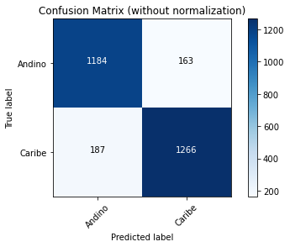
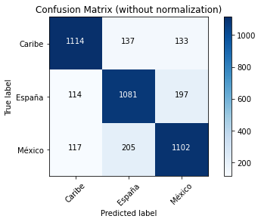
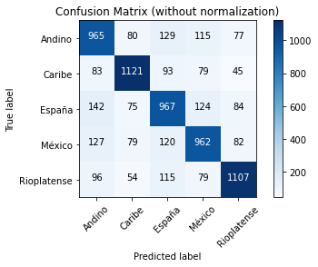
Results
ANDINO_CARIBE
MX_ES_CARIBE
MULTI
Notes:
Diego: Here are some of the results using a confusion matrix.

Slide 25
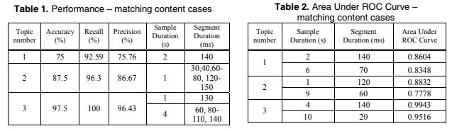
Comparing evaluation: pedersen 2007
Notes:
Diego:
Are these the best results?
NO. ASR systems should be very precise, so even though our scores are high, they don’t meet the expectations
Here is a comparison with one of the papers.

Slide 26
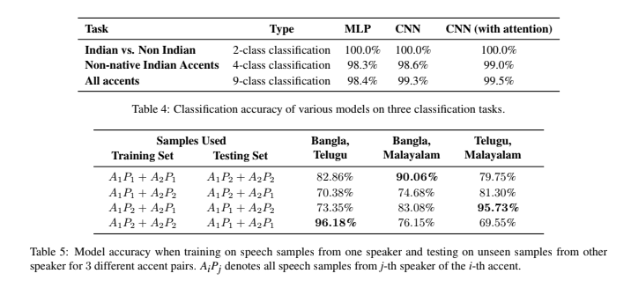
Comparing evaluation: ahamad 2020
Notes:
For newer experiments, we have this results from a project classifying english accents from indian and non indian speakers

Slide 27
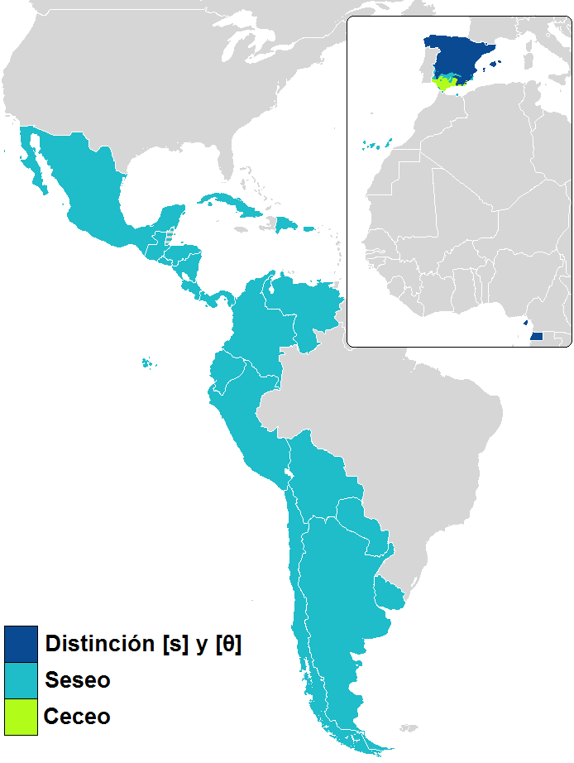
Discussion: CHALLENGES
Conflating Iberian and Andino accents (there are different accents in Spain, the Andino region accents don’t sound equal.)
Accents within a country can sound different depending of the State/Province or region.
Many recordings for Andino are from Colombian speakers. Their accent sound different to Ecuadorian or Peruvian.
Some Ecuadorian accents sound like Mexican
Immigration status, educational level, other sociolinguistic factors which may affect the way someone speaks, are not disclosed in the metadata
Notes:
Stef - Some countries have very similar sounding accents while some countries have accents within teh country that are veeeeery different

Slide 28
Discussion: CHALLENGES
Data Quality
Incorrectly labeled data. Some files are labeled as Mexican, but are from Spain
Audio quality differs for each file, not standard hardware or location for recording.
Preprocessing
Should have cleaned files that included recording of <5 words (open-source dataset is not as high quality)
Demographic Imbalance
Most speakers are men
Age
Older speakers have more pronounced accent differences
Younger speakers features homogenized by things like internet and media

Slide 29
EXAMPLE: Mislabeling in the dataset
Weird files
common_voice_es_19723697.wav Mexican but sounds like España
common_voice_es_21996991.wav Mexican sounds like Andino (Colombian)
Wrong label
common_voice_es_22165852.wav It is España but is labeled as Mexico

Slide 30
Discussion: Future work
We found that it is possible to create a Spanish Accent Classification Model
Improving the scores highly depends on the data.
More attention for Preprocessing & Postprocessing
Pre:
Add F0 (pitch), weight F1, F2, F5, Disaggregate
Post:
Feature Importance
Hand-write rules (e.g. Argentina ‘sh’ = F5-F6)
Variation amongst utterances: Mozilla has a great deal of variation, while other studies have used SVMs trained on datasets with a narrow range of repeat utterances; could this divide in the data lead to deprecated results?
Notes:
Took out “Recommend the use of standardized or similar hardware to improve the quality of the recordings” cuz actually nto suuuuper important. And ultimately goal is to not have that matter

Slide 31
DEMO

Slide 32
References
Duduka , S., Jain, H., Jain, V., Prabhu, H., & Chawan, P. (2020). Accent Classification using Machine Learning . International Research Journal of Engineering and Technology (IRJET), 7(11), 638–641.
McFee, Brian, Colin Raffel, Dawen Liang, Daniel PW Ellis, Matt McVicar, Eric Battenberg, and Oriol Nieto. “librosa: Audio and music signal analysis in python.” In Proceedings of the 14th python in science conference, pp. 18-25. 2015.
Pedersen, C., & Diederich, J. (2007). Accent classification using support Vector Machines. 6th IEEE/ACIS International Conference on Computer and Information Science (ICIS 2007). https://doi.org/10.1109/icis.2007.47

Slide 33
[1]
N. Bailón-Miguel and M. del P. Angeles, “A Comparative of Spanish Encoding Functions - Efectiveness on Record Linkage:,” in Proceedings of the Fifth International Conference on Telecommunications and Remote Sensing, Milan, Italy, 2016, pp. 105–113. doi: 10.5220/0006227701050113.
[2]
D. Stantic and J. Jo, “Accent Identification by Clustering and Scoring Formants,” vol. 6, no. 3, p. 6, 2012.
[3]
A. Aksenova, A. Bruguier, A. Ritchart-Scott, and U. Mendlovic, “Algorithmic Exploration of American English Dialects,” in ICASSP 2020 - 2020 IEEE International Conference on Acoustics, Speech and Signal Processing (ICASSP), Barcelona, Spain, May 2020, pp. 7374–7378. doi: 10.1109/ICASSP40776.2020.9053751.
[4]
P. Berjon, A. Nag, and S. Dev, “Analysis of French phonetic idiosyncrasies for accent recognition,” Soft Computing Letters, vol. 3, p. 100018, Dec. 2021, doi: 10.1016/j.socl.2021.100018.
[5]
P. Berjon, A. Nag, and S. Dev, “Analysis of French phonetic idiosyncrasies for accent recognition,” Soft Computing Letters, vol. 3, p. 100018, Dec. 2021, doi: 10.1016/j.socl.2021.100018.
[6]
Z. Elloumi, L. Besacier, O. Galibert, and B. Lecouteux, “Analyzing Learned Representations of a Deep ASR Performance Prediction Model,” in Proceedings of the 2018 EMNLP Workshop BlackboxNLP: Analyzing and Interpreting Neural Networks for NLP, Brussels, Belgium, 2018, pp. 9–15. doi: 10.18653/v1/W18-5402.
[7]
S. Kakouros, O. Räsänen, and P. Alku, “Comparison of spectral tilt measures for sentence prominence in speech—Effects of dimensionality and adverse noise conditions,” Speech Communication, vol. 103, pp. 11–26, Oct. 2018, doi: 10.1016/j.specom.2018.08.002.
[8]
J. Eisenstein, “Natural Language Processing,” p. 587.
[9]
F. M. Tyers, “What shall we do with an hour of data? Speech recognition for the un- and under-served languages of Common Voice,” p. 13.

